Slide 1
COAL-FO Beta Release Progress Report
Bryce Egley, Kenny Thompson

Slide 2
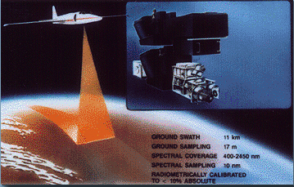
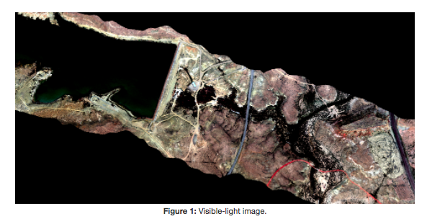
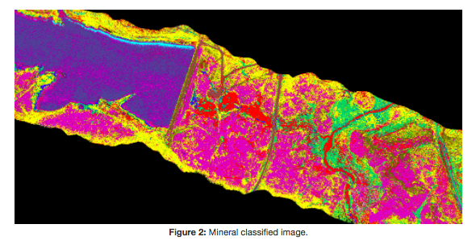
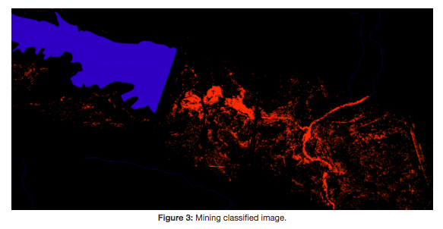
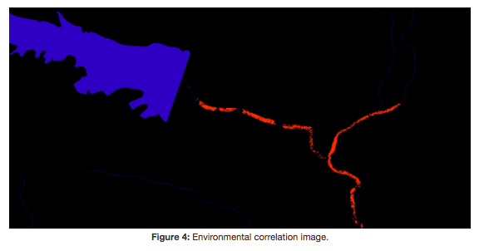
Project Overview-Group Intro
Presenter: Bryce Egley

Slide 3
What I have been working on
Alpha Release End of Week 6
Week 7 - Week 8 (Feb 19 - March 3)
Getting more data and running data through pycoal
Week 8 - Week 9 (March 1 - March 7)
Looking into GDAL rotation bug, and fixing gdal installation instructions
Week 9 - Week 11 (March 7 - March 21)
Updating to Spectral Library Version 7
Create convert function can also be used for ECOStress and EcoSIS spectral libraries
All of this is reflected on GitHub and my weekly OneNotes
Presenter: Bryce Egley

Slide 4
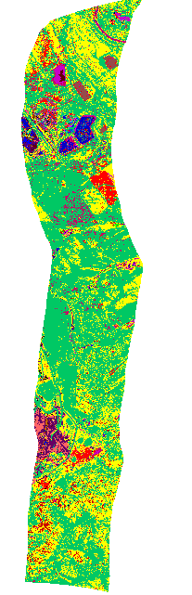
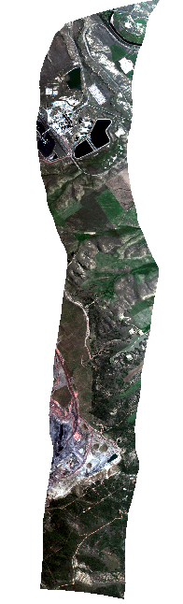
Getting More Data
North West Colorado
Site Name: Craig Power Plant
Size: 6 GB
I found several images of another Coal Mine in Colorado. Current default image for pycoal is 17.5 GB
Presenter: Bryce Egley

Slide 5

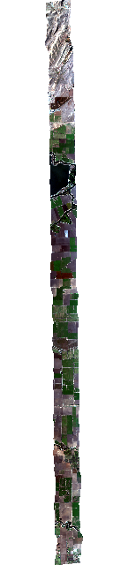
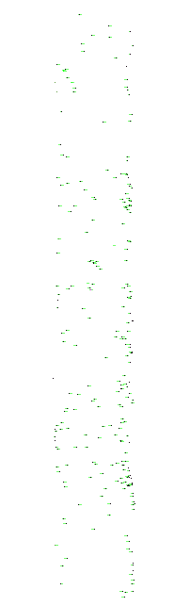
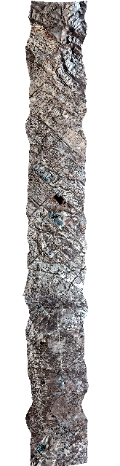
Getting More Data
Bakersfield, CA
Site Name: COAL 2
Size 6 GB
East of San Francisco, CA
Site Name: Delta 57 Zone 2 and Sulphur Mine
Size: 22.4 GB
I found several images of a sulphur mine in California, East of San Francisco and in Southern California
Presenter: Bryce Egley

Slide 6
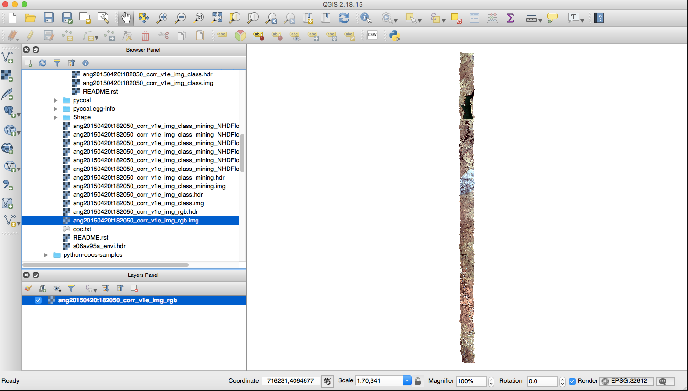
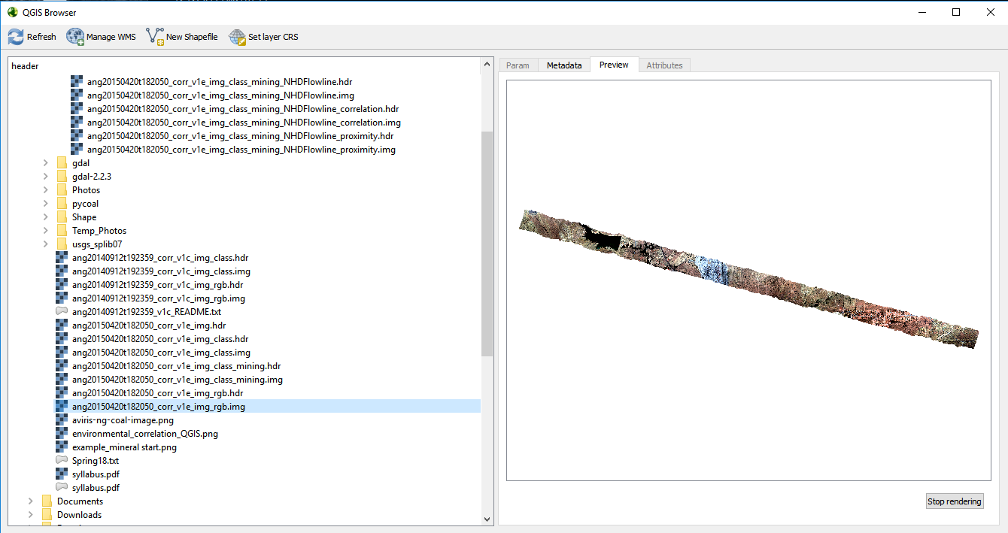
Fixing GDAL installation instruction
Upgraded GDAL installation instructions on capstone-coal.github.io. The old way used Debian which was mainly for GNU/Linux systems.
It appears that GDAL fixed the rotation bug.
However Mac QGIS always displays images vertically. Windows QGIS correct
Presenter: Bryce Egley

Slide 7
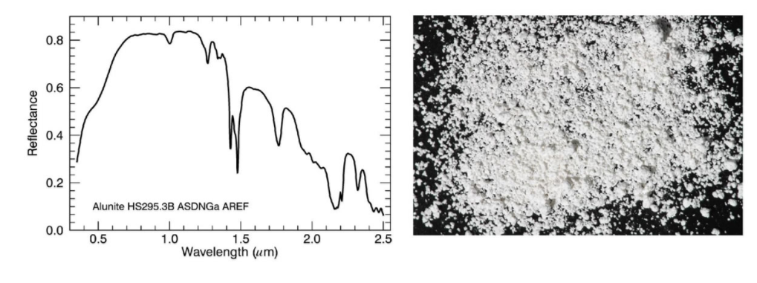
Upgrading to USGS Spectral Library Version 7
Currently, pycoal is using USGS Spectral Library Version 6
USGS - United States Geological Survey
Spectra is file of wavelengths for a specific mineral after light is reflected off it
Pycoal matches the wavelengths from the AVIRIS and AVIRIS-NG images to Spectra currently from Spectral Library Version 6
Presenter: Bryce Egley

Slide 8
Upgrading to USGS Spectral Library Version 7
To use Spectral Library pycoal requires envi .sli and .hdr files. Which are quick lookups of Spectral Library.
Spectral Library Version 4 - 6 have the envi .sli and .hdr convolved libraries here ftpext.cr.usgs.gov/pub/cr/co/denver/speclab/pub/spectral.library/splib06.library/Convolved.libraries/
My job was to create the convolved library envi .sli and .hdr files for Spectral Version 7
I created a convert function in mineral.py using ASTER to do this
This convert function can easily be changed to get the ECOStress and EcoSIS Spectral Libraries. Improving our classifications which was a goal on our requirements document
Staged products here https://drive.google.com/drive/folders/1YVhdLxvrZE3eC97OEXathLMJRgWt8haO
Presenter: Bryce Egley

Slide 9
My plans for the future
Modified convert function for Spectral Version 7 Library to work on EcoSIS and EcoStress Spectral Libraries
2) Update Coal Website to accommodate for changes to Spectral Libraries
3) Make pycoal algorithms faster so it doesn’t take as long to run mineral classification
4) Crop default pycoal image or find smaller image to use as default example
More info on these issues here: https://github.com/capstone-coal/pycoal/issues
Presenter: Bryce Egley

Slide 10
Kenny Thompson
-Past: COAL-SDS/AWS
-Current improvements
-Working display of current functionality
-Future

Slide 11
Coal-SDS
-The goal for this aspect of the project is development of tools we can use to process massive amounts of data
-Most of the work up tell now has been preparing everything to start processing the data
-We finally have everything prepared to run, and have begun the process of powering through the data we want to feed into it

Slide 12
Amazon Web Services
-Initially the project had a grant to use XSEDE services
-We began testing initially on AWS because of the ease of use, did not end up porting to XSEDE
-Amazon web services does give a free student tier that has been useful in processing data, and giving us comporable results to XSEDE
-Currently only staged on AWS

Slide 13
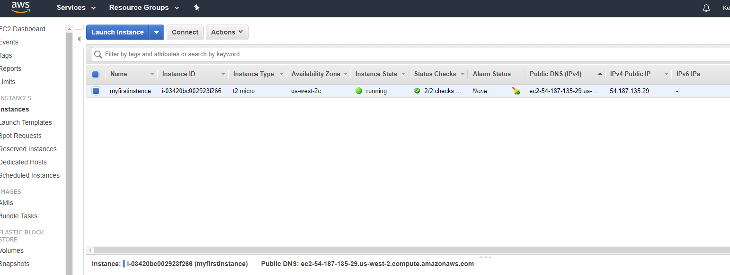
Current AWS Instance running File Manager

Slide 14
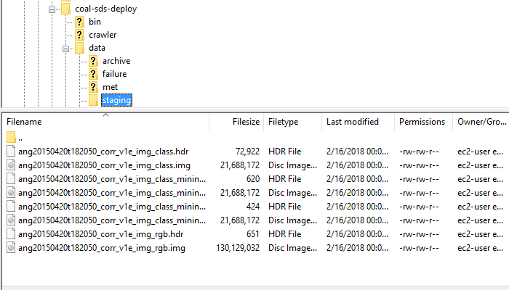
Current File Manager Staging

Slide 15
Other improvements to project
-Several issues with the documentation being ported over from old project
-Collaborated on several aspects of PYCOAL
-Updated several obsolete tools to current versions

Slide 16
Demonstration of functionality
-The now functioning build on AWS of Apache OODT with Coal-sds integration
-The ability to stage files, and process data

Slide 17
Future
Beta goal was to make improvements upon the alpha, and possibly explore porting to XSEDE
XSEDE port ended up not happening, at least not at this time
Possibly start importing real data soon
Handed off COAL-SDS management to Lewis
Future will involve improving metadata collection

